Slide 1
Hacker news website redesign

Slide 2
TEAM
N.Yeshwanth | 19071A3238
M.Shiva Prasad | 20075A3204
Mohammed Imran | 20075A3205
Nenavath Rahul | 20075A3206

Slide 3
aGenda
Introduction
Existing System and its problems
Proposed system
Problem Statement and objectives
Usability principles or Heuristics Evaluation

Slide 4
1. Introduction
Let’s start with the first set of slides

Slide 5
Introduction
Hacker News :
Hacker News (sometimes abbreviated as HN) is a social news website focusing on computer science and entrepreneurship. It is run by the investment fund and startup incubator Y Combinator. In general, content that can be submitted is defined as "anything that gratifies one's intellectual curiosity
Link of website:
https://news.ycombinator.com/

Slide 6
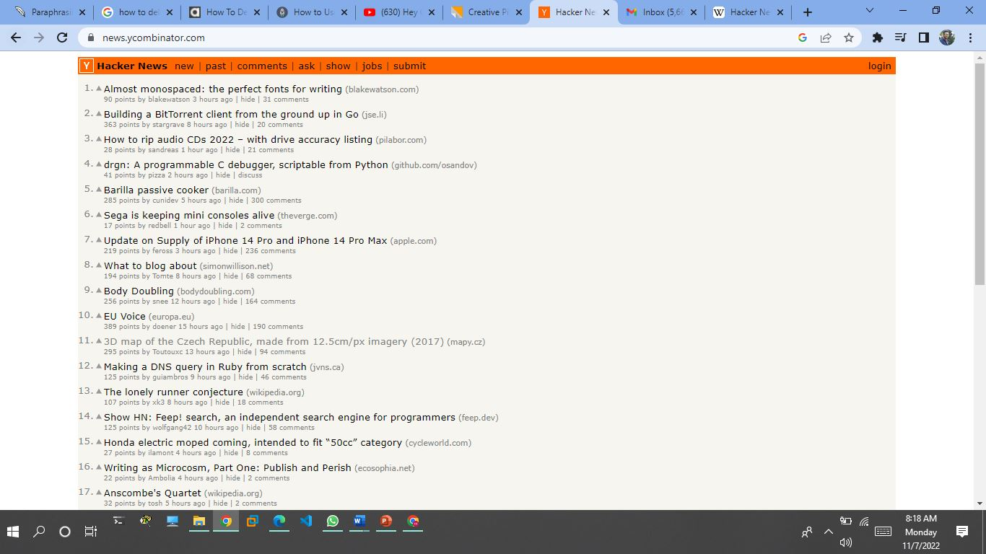
WEBSITE

Slide 7
2. Existing System and its problems
Let’s start with the first set of slides

Slide 8
Existing System and its problems
The site was created by Paul Graham in February 2007.
It developed as a project of Graham's company Y Combinator
The site is one of the biggest news aggregator websites available today with more than 12 million people visiting every month. Yet it still features the same design it used back in 2007.
Problems:
The site still features an unfriendly design that needs to be revamped.
You can’t open the Hacker News thread by clicking on the title.
The font is way too small and makes it hard to read.
The website consists of nothing but text.

Slide 9

3.
Proposed system

Slide 10
Creating better user experience.
Decreasing eye strain.
We will add searchbars for news search and as well as for jobs also.
We will increasing trafficking of website.

Slide 11
4. Problem Statement and objectives

Slide 12
Problem Statement
Hacker News is like Reddit for startups, programmers, and entrepreneurs. It is a social news website focusing on computer science and entrepreneurship. It is run by the investment fund and startup incubator Y Combinator.
The Hacker News application has development issues, which leads to poor usability for the user, and the iOS application has a non-functional user interface, which results in an annoying user experience, and the users face a lot of difficulty with respect to its functionality and experience a lack of inadequate features.

Slide 13
Objectives
Creating a UX that meets your customers' needs while also aligning with the brand's goals results in interactions that are beneficial and meaningful to both your company and your users.
To align your user experience with the brand's goals: Create a design that is unique to the company.
Giving priority to their safety and security by limiting access to sensitive information to provide the best user experience.
Functionality to improve the user experience.
Updating the online platform and fixing bugs on a regular basis.

Slide 14
7
Usability principles
Heuristics Evaluation

Slide 15
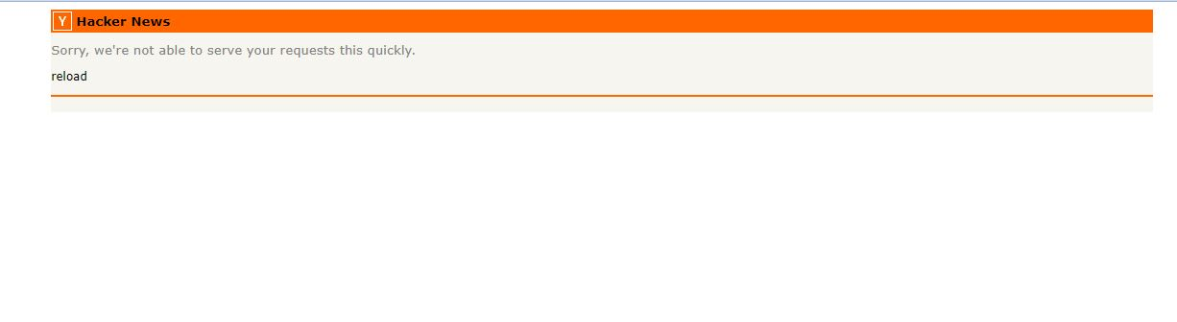
1. Visibility Of System Status
The user receives all information related to which page they are on, and if anything goes wrong, it indicates that they are on the incorrect page. As a result, the user will be aware of the action being carried out and will not have to wait for the results. For example, if we login with the incorrect user id and password, an error message appears.
Heuristic Violated: No

Slide 16
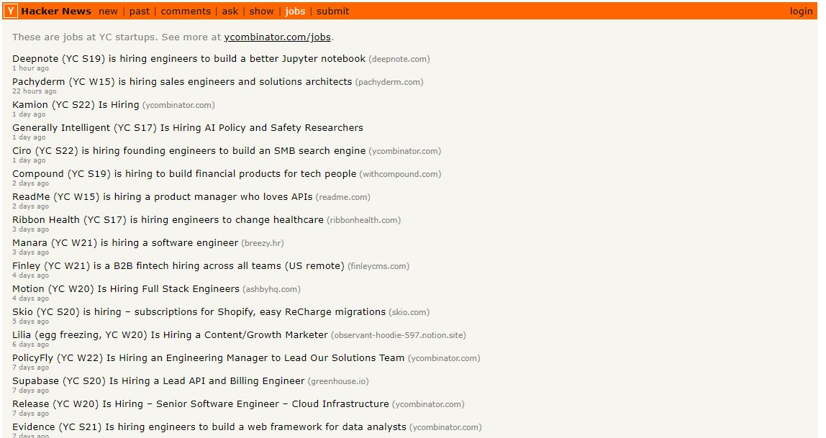
2. Match between System and Real World
Hacker News (abbreviated HN) is a social news website that focuses on computer science and entrepreneurship. Its also used for job search.
Real-world conventions are followed, making it very user-friendly. Heuristic Violated: NO

Slide 17
333. User Control and Freedom
The user can switch to any desired option in the web application at any time. The user possesses the access to the website's content The user is free to browse available trains until and unless he/she is redirected. Reserving a seat In that case, he or she logs in or registers on the website.
Heuristic Violated: YES

Slide 18
4. Consistency and Standards
Even they no update of website, the website maintains consistency by checking the available jobs, news& mainly focusing on computer science and entrepreneurship deeper insights.
Heuristic Violated: No

Slide 19
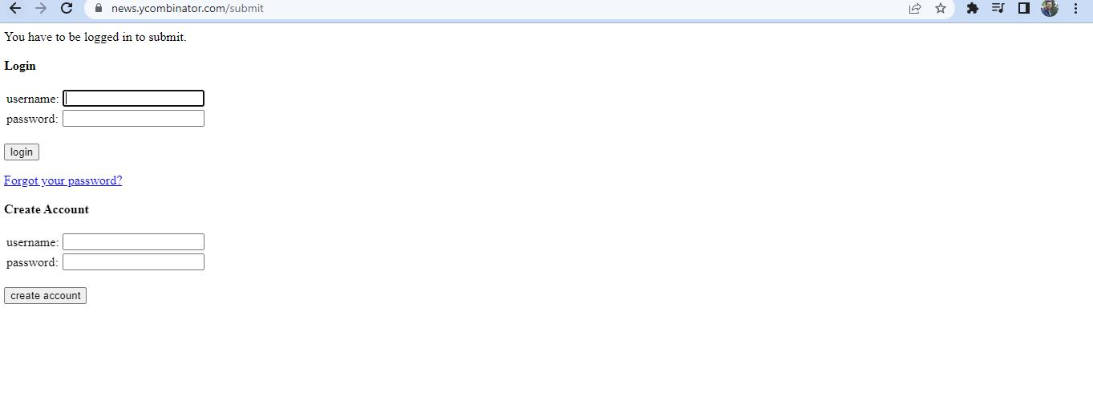
5. Error Prevention
When a user attempts to submit a button for any jobs or news on the website, he is redirected to the login page to open or create an account.
Heuristic Violated: No

Slide 20
6. Recognition rather than recall
The goal is to minimize the application of user memory.
Heuristic Violated: NO

Slide 21
7. Flexibility and efficiency of use
While a no vice user uses the website, he/she can easily see the news past and current Not only that, but the user can also get comments of job and news.
Heuristic Violated: No

Slide 22
8. Aesthetic and minimalist design
This website provides assistance and documentation, but it is located somewhere that we cannot access properly. There is an unfinished design, such as no settings feature. As a result, the website's design is incomplete, with some of its key features missing.
Heuristic Violated: Yes

Slide 23
9. Help users recognize, diagnose, and recover from errors
This website helps to recognize, diagnose and recover from errors ,for example if we login with the incorrect user id and password, an error message appears.
Heuristic Violated: No

Slide 24
10.Help and documentation
There is proper and detailed help available on the website, when the user clicks on the help center, they can find a lot of detailed information and common FAQs .
Heuristic Violated: No

Slide 25
Thanks!
Any questions?

